Slide 1

Growth Mindset

Slide 2

Growth Mindset
“You can learn new things but you can’t really change your basic intelligence…”
Strongly disagree
Disagree
Somewhat disagree
Somewhat agree
Agree
Strongly agree
Growth Mindset
Fixed Mindset
https://www.youtube.com/watch?v=5e4smtpKcuI
Notes:
2. Complete opinion scale
3. Show video

Slide 3

Growth Mindset
Fixed Mindset
“My Dad’s no good at maths so I’m not either”
“She always gets it right because she’s really clever”
“ I can’t do it. It’s too hard for me”
“Will I succeed or fail? Will I look smart or dumb?”
Believe qualities like intelligence and talent are fixed
Notes:
6. Explain concept of a fixed mindset

Slide 4

Growth Mindset
Growth Mindset
“I’ll use a different strategy”
“Mistakes help me to learn”
“There’s always plan B”
Notes:
8. Explain concept of a growth mindset

Slide 5
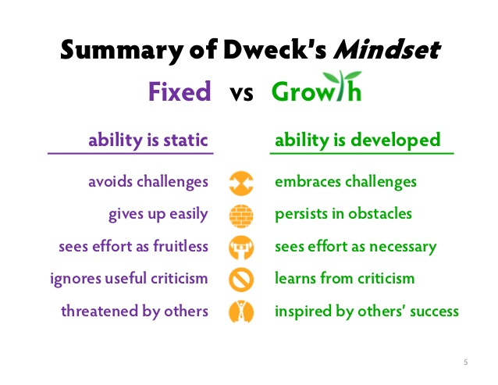

Slide 6
